Slide 1
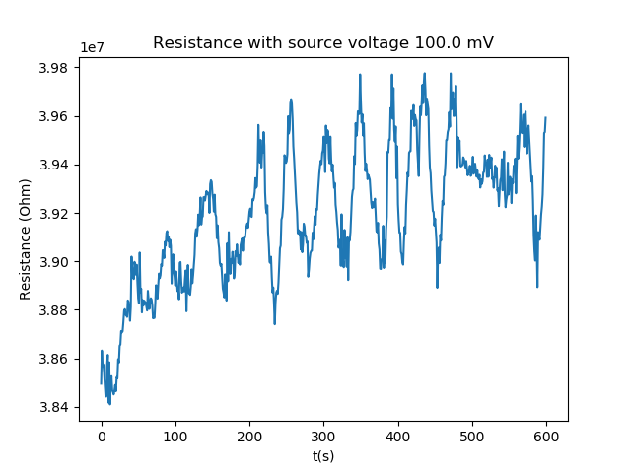
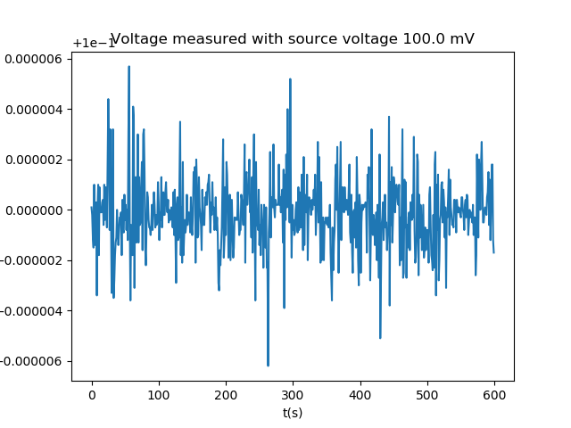
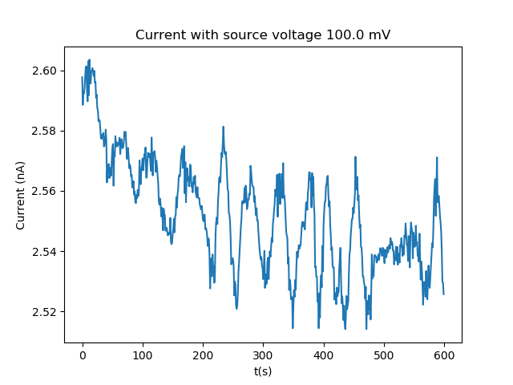
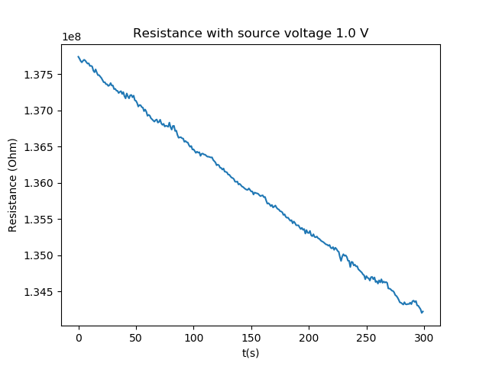
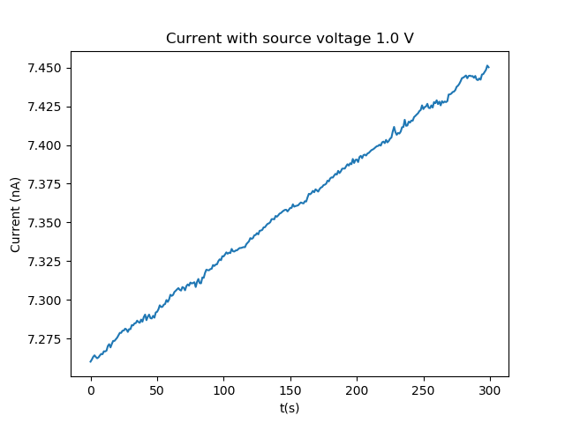
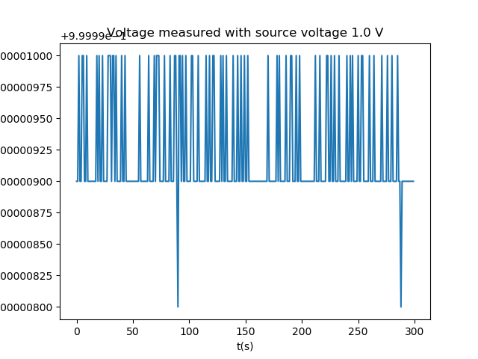
Coax vs USB noise performance
USB
1028_0950_wo3189_r1234
Measurement used to get resistivity of WO3 in vdP
Voltage sourced
Probably measured in 2wire mode
setpoint = 25
sample_rate = 1
source_volt = 1E2
limit_current = 1E-7
R = 3.92E+07 with std 2.81E+05
I = 2.55E-09 with std 1.84E-11
COAX
1231_1431_wo3196_r13_toprow
Temperature setpoint is 25 C
Sample rate is 1 Hz
Measurement time is 300 s
Source voltage is 1.0 V
Limit current starts at 1.5e-08 A
Mean resistance is 1.36E+08 with std 1.02E+06
Mean voltage is 7.36E-09 with std 5.5002E-11
Comparison between voltage sourced USB measurement of WO3189 and voltage sourced COAX measurement of WO3196
The current noise of both measurements is the same despite the cable change

Slide 2
Coax without feedthrough
Measurement config #3
Mean voltage is -3.36E+00 with std 2.94E-03
Measurements on 20191216 |  | Sample rate 1 Hz | Outside main chamber
2 or 4 point | # | Setup | Name | Mean | Absolute mean | Std
2 | 1 | Simple | 2_1_Simple | 3.38E+07 | 3.38E+07 | 5.00E+05
4 | 2 | Positive | 4_2_Positive | 3.35E+07 | 3.35E+07 | 4.53E+05
4 | 3 | Negative | 4_3_Negative | -3.36E+07 | 3.36E+07 | 2.17E+04
2 | 4 | Ground | 2_4_Ground | 3.30E+07 | 3.30E+07 | 3.69E+05
4 | 5 | Positive common ground | 4_5_Positive common ground | -6.71E+06 | 6.71E+06 | 4.44E+05
4 | 5 | Positive sense ground | 4_5_Positive sense ground | -7.13E+06 | 7.13E+06 | 1.40E+05
4 | 6 | Positive force ground | 4_6_Positive force ground | 3.33E+07 | 3.33E+07 | 2.67E+05
4 | 9 | Negative common ground | 4_9_Negative common ground | -4.04E+07 | 4.04E+07 | 5.60E+04
4 | 7 | Negative sense ground | 4_7_Negative sense ground | -4.04E+07 | 4.04E+07 | 1.90E+04
4 | 8 | Negative force ground | 4_8_Negative force ground | -3.36E+07 | 3.36E+07 | 4.31E+04
At first glance these measurements appear to have less noise than the previous, but the data here is only from the resistance data. So the reduced noise may come from a higher source current, the std of the voltage data should be conclusive.
As seen above, the std of the voltage data is simply lower than the other measurements.
Also, the source current is 100 nA here, which is the same for the other 33MOhm measurements.
One difference between these measurements and the ones with the feedthrough is that this setup uses two cables and the feedthrough one has 4 cables.
With two cables the outsides of the cables are connected to the negative ports, but with 4 wires the outsides are connected to the ground of the grid

